Slide 1
Model United Nations How to speak publicly
Notes:
Introduce yourself and any ambassadors, then intro the session

Slide 2
TODAY’S SESSION
What is public speaking
Why it important
Public Speaking tips - Voice
Public Speaking tips -Body Language
Practicing your MUN speech

Slide 3
INTRODUCTION TO PUBLIC SPEAKING
What do we mean by public speaking?
Giving a speech in front of a live audience
Essentially it can be to educate, entertain, or influence or all 3!
Major skill which takes time to master but practice is key!
Notes:
Ask students first what they think public speaking is then reveal the answer
The reality is that whenever you speak, in a sense you are performing, whether that’s in a casual conversation or answering a question in class, or an actual presentation.
The live audience? Whoever is listening to you. Your friends, family, the shopkeeper.
Ask students why they might need to speak publicly then reveal the second bullet point
Elaborate: Public speaking is used everywhere. It’s in an interview for a job where you have to prove you’re a worthy candidate. It’s to convince your friends to go to Thorpe Park next week. It’s for telling a story.

Slide 4
WHAT HINTS FOR PUBLIC SPEAKING CAN YOU FIND?
Notes:
Link to video on Youtube in case you need it: https://www.youtube.com/watch?v=8S0FDjFBj8o vid starts at 18 seconds
BEFORE PRESSING PLAY: tell the students that you’ll be playing a video of someone giving a Ted talk. During this talk, he will be dropping a couple of hints of public speaking, ask them to note them down.
After the video, ask the students to give feedback.

Slide 5
WHAT DID YOU GET FROM THE VIDEO?
Body language, using gestures properly
Pauses in sentences
Range of pitch – making what he is saying exciting through his tone of voice
Asking questions – getting the audience involved
Using an anecdote
Having flow with your ideas
Using the presentation for a visual cues and attention grabbing
Using numbers and graphs/pie charts
Using humour
Notes:
Make sure to emphasise that not all times of public speaking will need this. For example, if you’re talking about a serious topic, you wouldn’t necessarily inject humour. You might do so at the beginning to make you more likable and then once you’ve got their attention you go serious.
These are just some elements to help public speaking. What we are going to do now is go though some tips and life hacks for public speaking. We’re going to split that into two categories: Voice and Body Language

Slide 6
THREE MAIN QUESTIONS
Ask yourselves these before you start to prepare a speech or presentation

Slide 7
WHAT DO YOU WANT THEM TO KNOW?
WHAT DO YOU WANT THEM TO DO?
WHAT DO YOU WANT THEM TO FEEL?
Notes:
These are the three main questions you need to ask yourself before you start preparing a speech or presentation.
For Model UN, what would the response be for an opening speech? (ask students)
After getting feedback and if doesn’t really relate:
Know: What them to know what country you represent and what it is like. What the priorities are etc.
Do: Look at you as an ally
Feel: Connected to you

Slide 8
PUBLIC SPEAKING YOUR VOICE
THERE ARE 5 KEY TIPS FOR PUBLIC SPEAKING
THEY ALL BEGIN WITH P
PITCH
PERSONALITY
PACE
PAUSE
PROJECTION
Notes:
Ask students what they think the Ps might be.
Pitch- the rise or fall of your voice. We use this to emphasise different points of your speech. If you’re excited about what you’re talking about then your pitch would demonstrate that.
For example, if you want someone to do something, rather than saying “I want you to do this”, you’ll say “I want YOU to do this” – your emphasise is on “you”.
Being intentional with language.
Pace: if you think you’re speaking slowly, slow down further. Don’t speak so fast that people cannot understand you. Your audience must be able to hear and understand you properly.
Pause: A very effective tool to get people’s attention, emphasise certain points or even to give you some breathing space! Make sure to use these in the right moment.
Projection: You need to be able to be heard to the back of the room – but that doesn’t mean you need to shout!
Personality: Bring your best self to presentations. For MUN you will be role playing as a country, so you might assume a character, but again bring it back to the 3 main questions – what is your aim? If you want to be liked, you’ll want to speak in a nice warm tone, and not authoritarian “know it all” tone (Hermione Granger in film 1). Along with personality, your passion should come out in the right time.

Slide 9
PUBLIC SPEAKING YOUR BODY LANGUAGE
words
7% of the message comes from your
35% of the message comes from your VOICE
57% of the message comes from your BODY LANGUAGE
Notes:
This just shows the importance of your body language, not just your voice or the content of your speech.
But all three are important – each one you can work on
Most importantly, is the word Congruency.
Congruency means making sure what you are saying is matching with your body language

Slide 10
BODY LANGUAGE TIPS
P
L
A
POSTURE
LEGS
ARMS
T
E
S
TENSION
EYES
SMILE
Notes:
Introduce PLATES and say it’s an acronym for good body language.
Before revealing each heading, ask students what they think P stands for, if they get it right, reveal it, then move onto the next one (complete top level first then go to the bottom).
Elaboration:
Posture: To show you are confident, and to have people confident in you, your posture needs to reflect that. If doing this face to face, ask students to get up and stand with their legs slightly apart. Ask students to then jump and hold that stance. How they land is a good stance. Make sure back is straight and chin up.
Legs: Move with purpose, don’t move your legs a lot, it will show you are nervous and will distract your listeners.
Arms: Gestures are key, but make sure you use them right – with purpose
Tension: If your audience can see that you’re tense, they will become tense. To get rid of tension from your body tighten each muscle group in your body, starting at your toes. Tighten, tighten, tighten! Then release. This exercise will calm your body and focus your voice.
Eyes: Make sure you look at the audience and maintain some form of eye contact for no more than 3 seconds. A good method is using the Z pattern – move your eyes across the room in a Z pattern focusing on some members of the audience at points.
Smile: Smile as that would make you more warm and approachable, but don’t do it the whole time and make it forced. Start and end your speech with a smile.

Slide 11
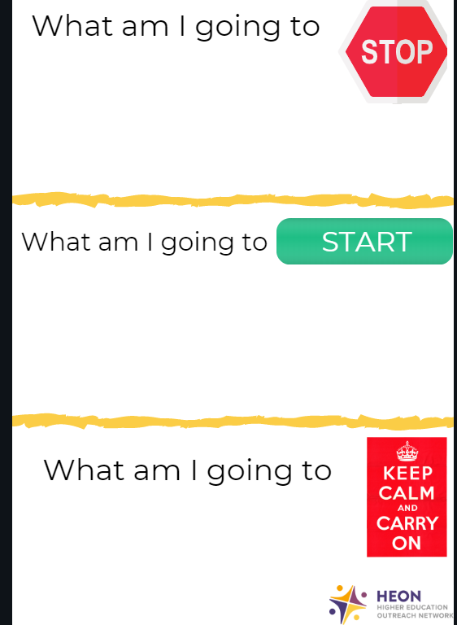
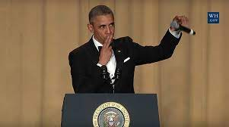
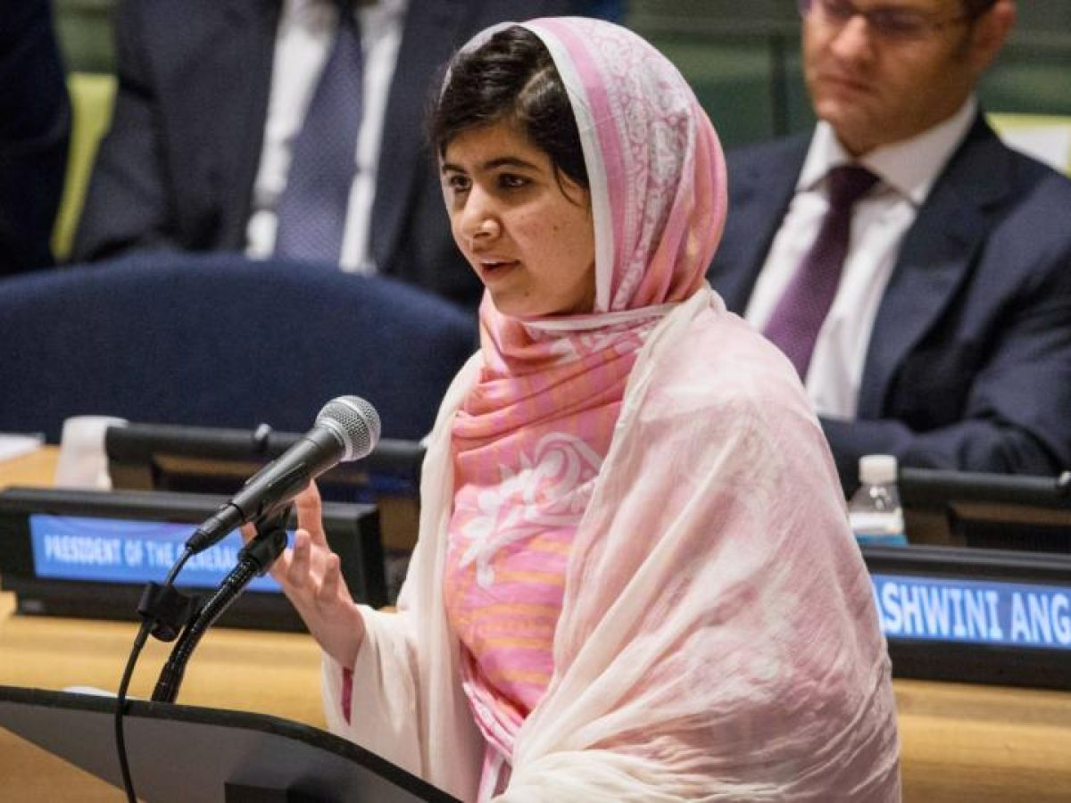
PRACTISING YOUR MUN SPEECH
Notes:
This is a really handy tool to know what you got out of this session.
In the first box, I want you to identify what you will stop doing; for example, I will stop mumbling my words or moving my legs when speaking
In the second box, identify some things you will start doing, for example, I will start to work on my voice projection by practicing my speech in a hall
In the third box, what will you carry on doing that you were doing before, for example I will continue to work on my posture.
Examples include the relaxed conversational style of Barack Obama and looking at Malala Yousafzai’s open body language as inspiration
Remember there are lots of tips in your research binder as well.

